Slide 1

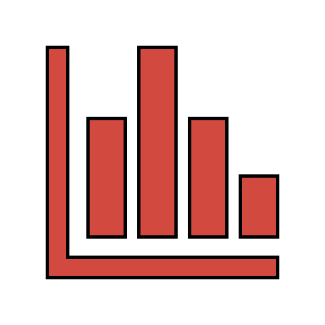


Smart Grid Security – Attack and Defense Stratagems
CSC 6222
Wasfi Momen
11/28/18

Slide 2
Overview
Background on Smart Grid Security
False Data Injection Attack
Popping the HMI Attack
Privacy Attack
Conclusion

Slide 3
Background
Much work done in the realm of Smart Cities is still in the beginning stages of development.
NIST (National Institute of Standards and Technology) Smart Grid Version 4.0 in development this year, last release v3.0 was in 2014.
Widespread adoption is yet to be implemented across power generation, transmission, distribution, service provider, and end user.
The core of the Smart Grid, the SCADA system, does not have widespread adoption of new standards.
Will take time for full adoption. Current laws and regulations only call for research and study, not implementation.

Slide 4

False Data Injection Attack
Integrity Violation
Attacks influences the distribution, end user, and service provider.
Frameworks use known techniques like State Estimation aka a linear regression model:
Which are used in many of solutions, but a diversity of solutions are what matter.
Can use state estimation and mathematical algorithms
Or can use Machine Learning algorithms (Chen et al.)
$$z= Hx+e$$
Notes:
Attack can either be one of these parties or none of them
z = state variables (voltage angles) and meter measurements, H estimation function, x is the estimate
Chen paper focuses on Space time considerations and training ML to see load balance

Slide 5
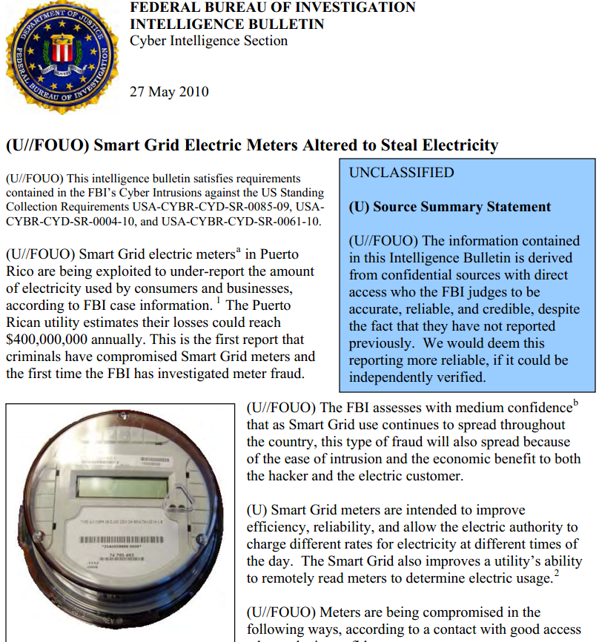
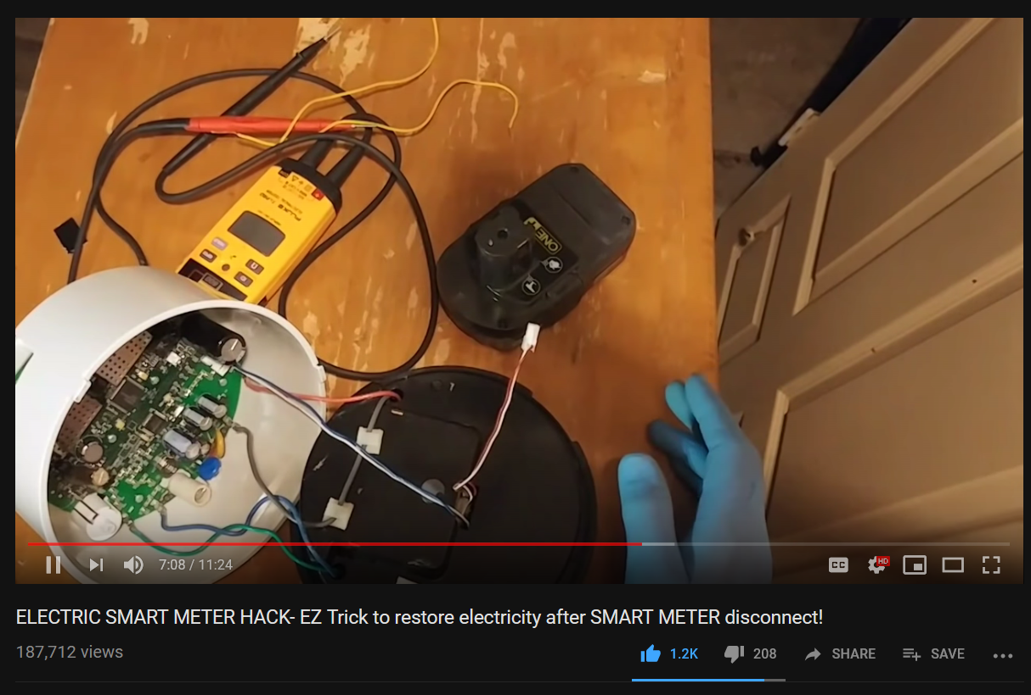
…But the basics matter
https://krebsonsecurity.com/2012/04/fbi-smart-meter-hacks-likely-to-spread/comment-page-1/
https://www.youtube.com/watch?v=CjrJjMNrqsI
Notes:
FBI catches Puerto Rico widespread modification of smart meters
Will cost up to 400 million dollar damages
Youtube video on right is how to hack one
blue-white wire reports back to company, can disconnect to keep price stable
Switches decide whether to access line

Slide 6
Defense for False Data Injection
Implement IEC 62056-21
Adds passwords, both simple and encrypted
Adds handshaking
Still vulnerable to attacks, but better than nothing
Machine learning algorithms
Dealing with low-risk part of the grid
Can provide additional information and adaptable
Consensus
Notes:
- IEC 62056: Guidelines for smart metering standardization

Slide 7
Popping HMI attack
Lots of different vectors, but let’s focus on timing attacks.
Attacker’s aim to discover network topology
On power generation
Especially target devices that return either <3msec or <10msec according to IEC 61850
Attack on privacy and security
Attacker can exploit the web browser to gain information of critical systems.
Request information of target systems in substation
Over a large sample of requests, the timing of the device can be traced to specific devices
Notes:
IEC 61850 determines single substation requirements for message type and performance
Popular method of identifying generation circuits, similar to internet relays Room 641A

Slide 8
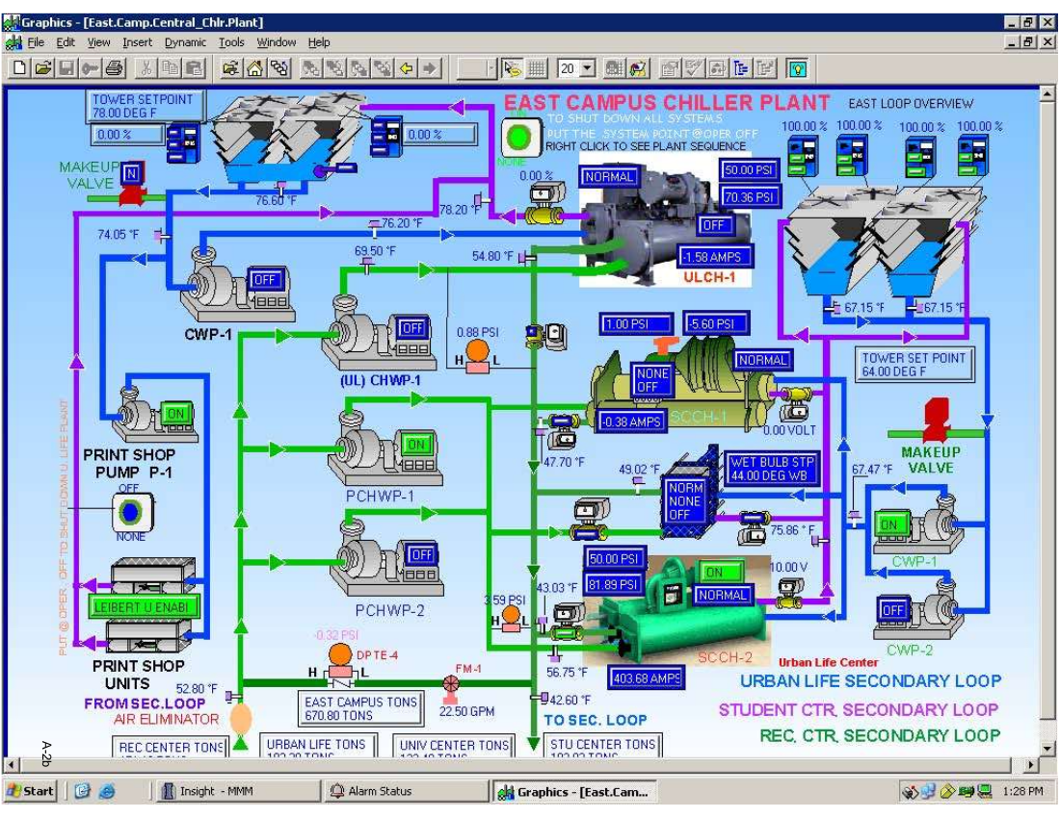
HMI examples

Slide 9
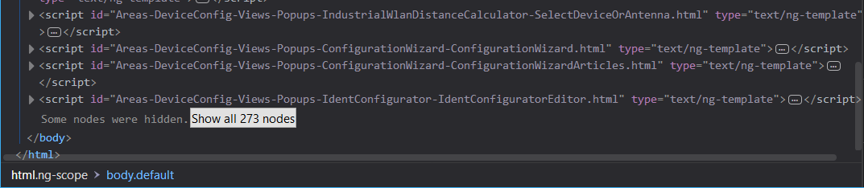
HMI examples

Slide 10
Defense on HMI timing attack
Deterministic browser
Aims at making all operations within browser at constant time
Across all browsers in the SCADA network, this time should be the same
Attackers viewing HMI will no longer be able to sniff timings at least
As long as browsers use HTTPS or some other encryption
Doesn’t protect against “over-the-shoulder” pixel snooping
Notes:
- For full implementation will attempt to simulate a substation using available tools, however online tools are picky.

Slide 11
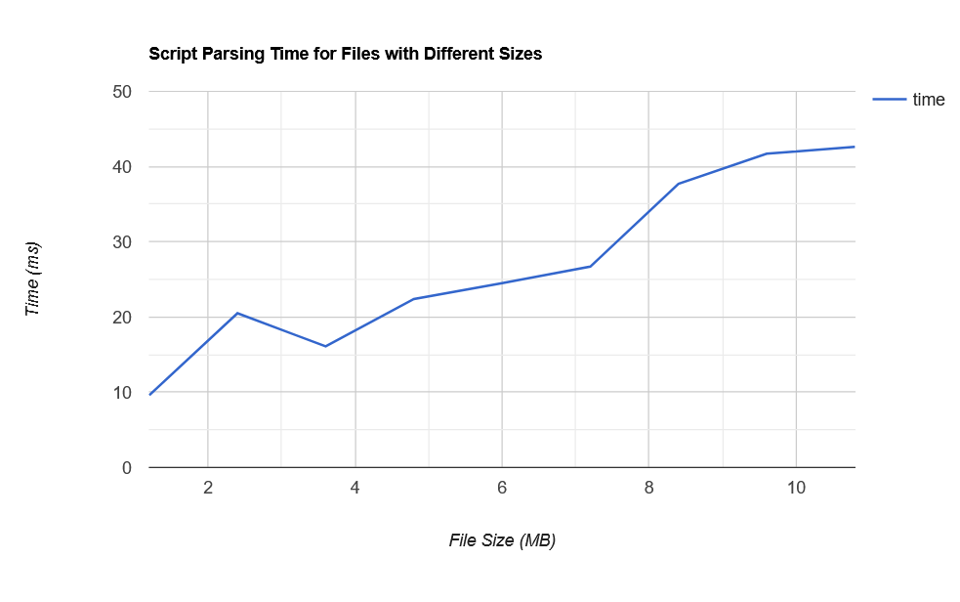
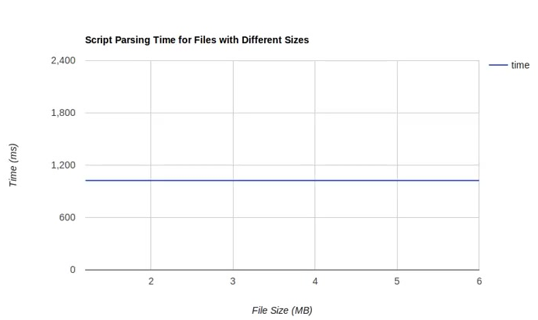
HMI examples
Notes:
- For full implementation will attempt to simulate a substation using available tools, however online tools are picky.

Slide 12
Privacy Attack
The Smart Grid is filled with more than just powers stations and houses; more attack space
Attackers aim to disclose personal information on targets by using the Smart Grid
Attacks confidentiality
Falls under reconnaissance rather than exploitation
RTUs (Remote Terminal Units) and Smart Vehicles will be targeted
Both include aspects of Geo-locational Privacy

Slide 13
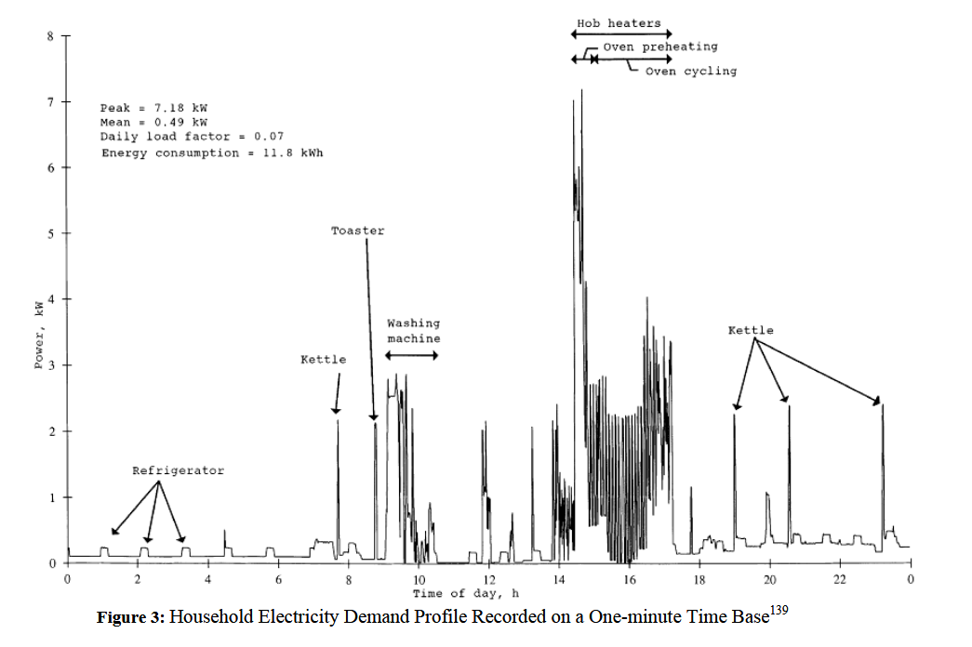
Power Profiles
Notes:
- For full implementation will attempt to simulate a substation using available tools, however online tools are picky.

Slide 14
Defense on Privacy Attack
Use of privacy preservation algorithms
Recommended for use in uncontrolled end user and service provider relations. Can be implemented via generation, transmission, distribution side, but not really required.
For power grid network, we can use RAPPOR, a Google algorithm for privacy.
For RTUs and Vehicles, we can focus on Geo-Indistinguishable Privacy
Also can prevent against Time Synchronization Attacks
Notable paper: MixGroup: Accumulative Pseudonym Exchanging for Location Privacy Enhancement in Vehicular Social Networks
Notes:
- Perturb the power grid dataset

Slide 15
Conclusion
Solutions exist for a wide variety of attacks presented in the Smart Grid realm
Many are already being worked on with SCADA, the core of the Smart Grid
Need focus on eliminating “security through obscurity” problems
Security via software is ongoing through standardization; yet to see work on Privacy group considerations
Software and frameworks must learn from the past and be adaptable for new, unpredictable technologies

Slide 16
Bibliography
Cao, Y., Chen, Z., Li, S. and Wu, S. (2018). Deterministic Browser. [online] Arxiv.org. Available at: https://arxiv.org/abs/1708.06774 [Accessed 28 Nov. 2018].
Chen, P., Yang, S., McCann J., et al. (2018). Detection of false data injection attacks in smart-grid systems - IEEE Journals & Magazine.
Liu, Y., Reiter, M. and Ning, P. (2018). False data injection attacks against state estimation in electric power grids.
Yu, R. (2018). MixGroup: Accumulative Pseudonym Exchanging for Location Privacy Enhancement in Vehicular Social Networks
Quinn, E. (2018). Privacy and the New Energy Infrastructure.

